Slide 1


Employee Payroll Management
Group -2
Akshay Uttam Mali 2478468
Aligeti Sravan kumar 2478115
Ashwini Ramesh Bagal 2478746
Bharath Teja Paapana 2479443
Jeevan TT 2478789
Dalanna Gari Naveen Kumar 2478431
M LOWKYA 2479372
Ravi Kumar 2478842
S Balaji 2479129
Shreja Jagadish Sakhare 2478327

Slide 2

Bibliography
www.google.com
www.javatpoint.com
www.youtube.com
www.stackoverflow.com
WWW.spring.io

Slide 3

Contents
Objective
Tools & Languages used
System Requirements
App Flow
E-R Diagram
Features of Employee payroll management
Future scope and improvements
Conclusion

Slide 4

Objective
The Primary objective of the design is to deliver the requirement as delivered by the feasibility report. There are some objective we kept in mind.
Practically : The system is quite stable and can be operated by the Employees with average intelligence.
Efficiency : We tried to involve accuracy, timeliness and comprehensiveness of system output.

Slide 5







Tools & Languages used
Front End
Back End
Angular
HTML
CSS
BOOTSTRAP
Visual Studio
Spring Tool Suite
MySQL
Hibernate
Postman

Slide 6
System Requirements
The Basic System Requirements for Running this project are listed below:
Angular, STS, Postman and MySQL to be installed to the system
572 MB Random Access Memory
200 MB of Free Space on Hard Disk
Microsoft Windows XP or Linux or Equivalent OS
Web Browser

Slide 7
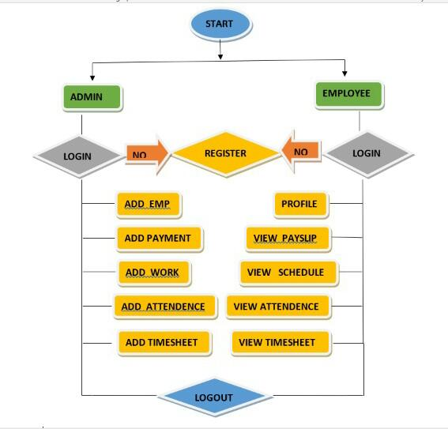
App Flow

Slide 8
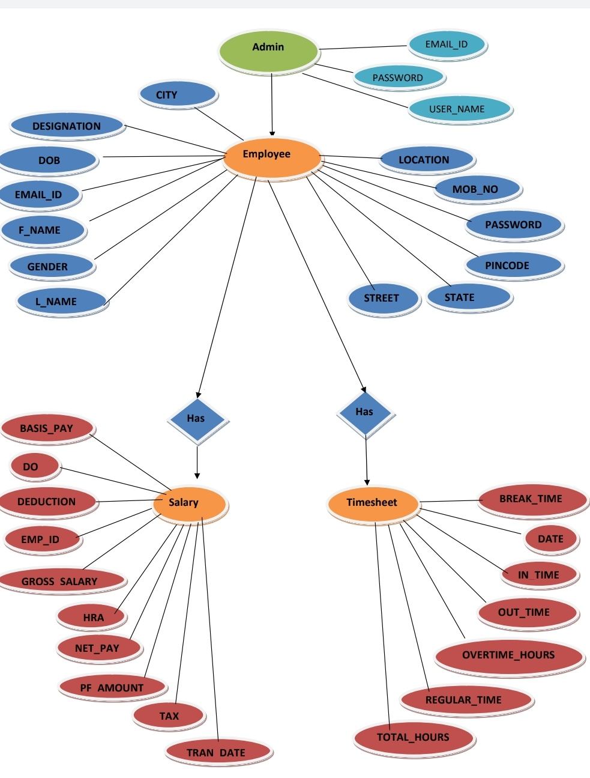
E-R Diagram

Slide 9



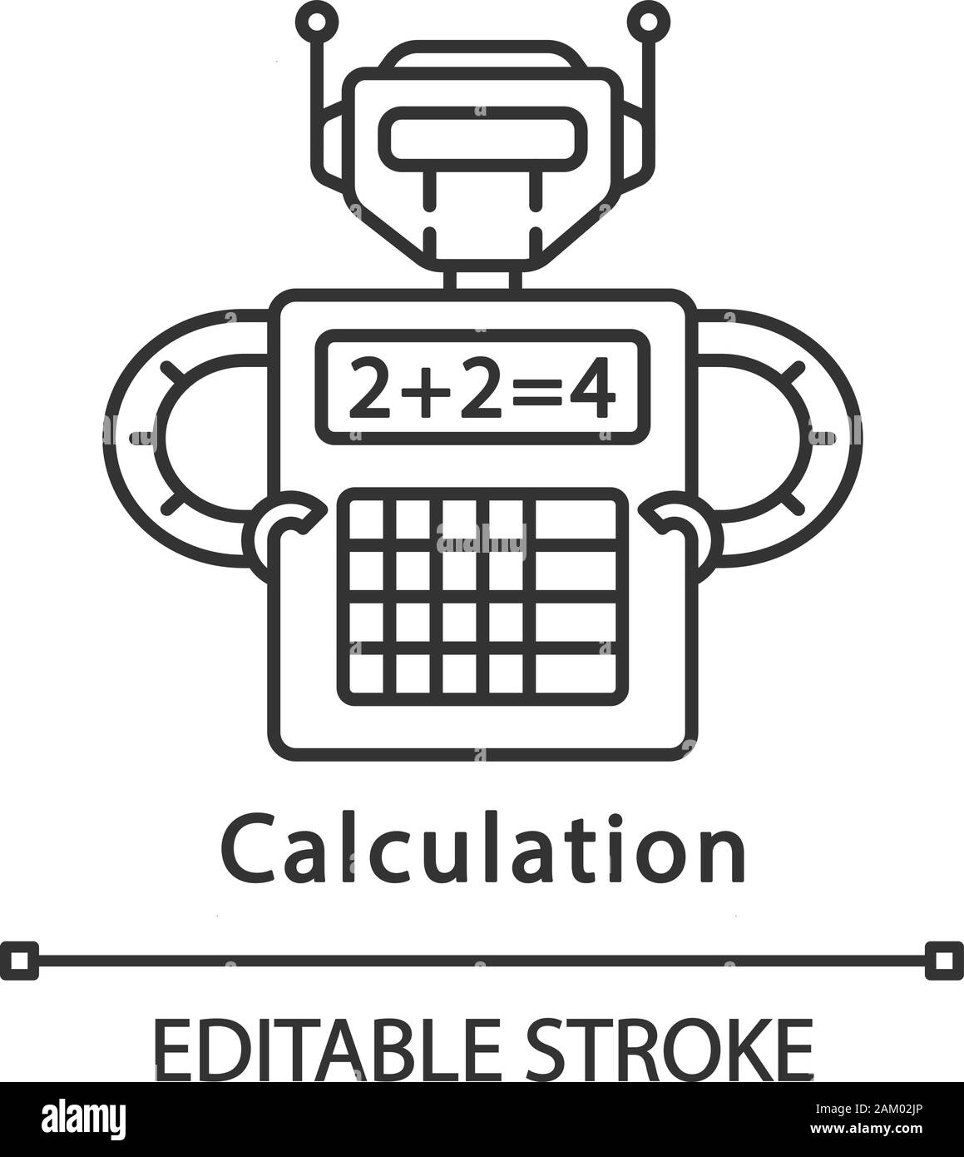
Features of Employee payroll management
Easy to use.
It is completely secure.
It is completely controlled by admin.
This system is easily compatible with most of the web browsers.
It is very interactive and saves time.
Reduces paper works.
Calculations are automated so it is highly accurate.
Admin can view all the records whenever necessary with ease.

Slide 10
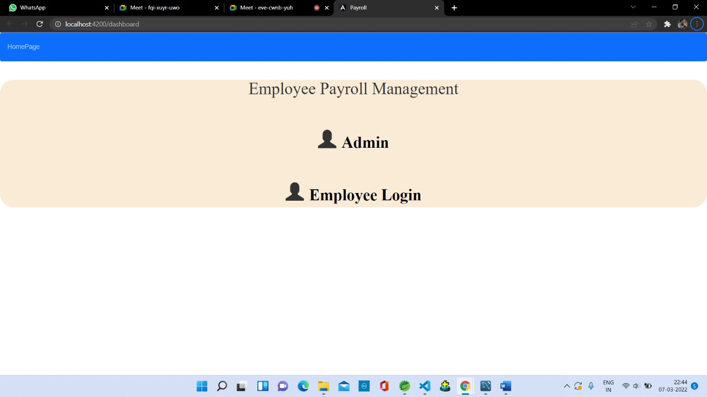
Output Screenshot
Homepage:

Slide 11
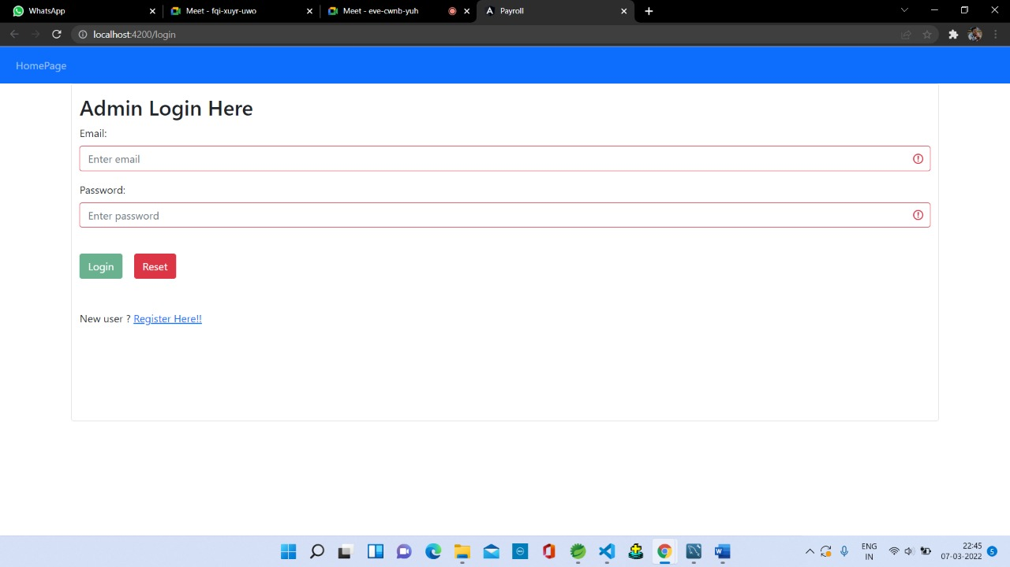
Admin login

Slide 12
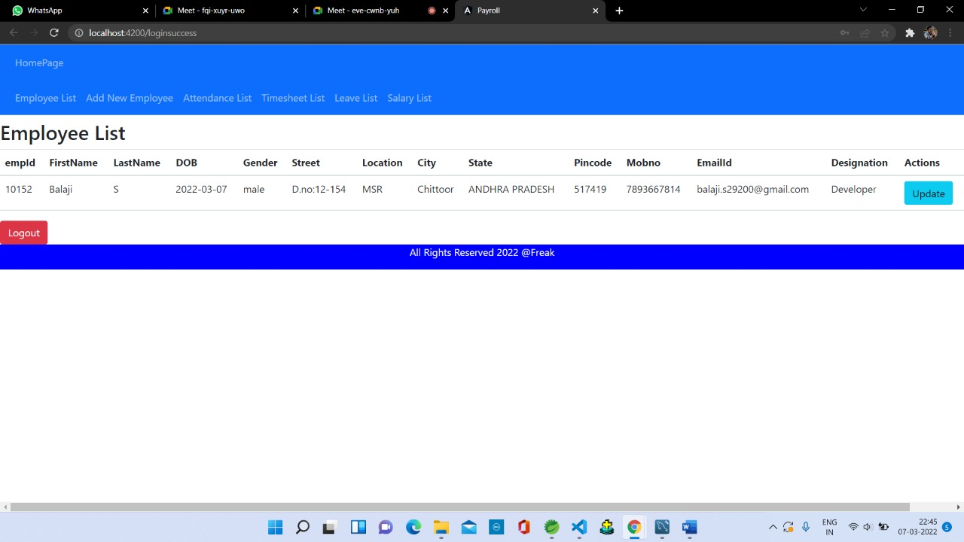
Employee list

Slide 13
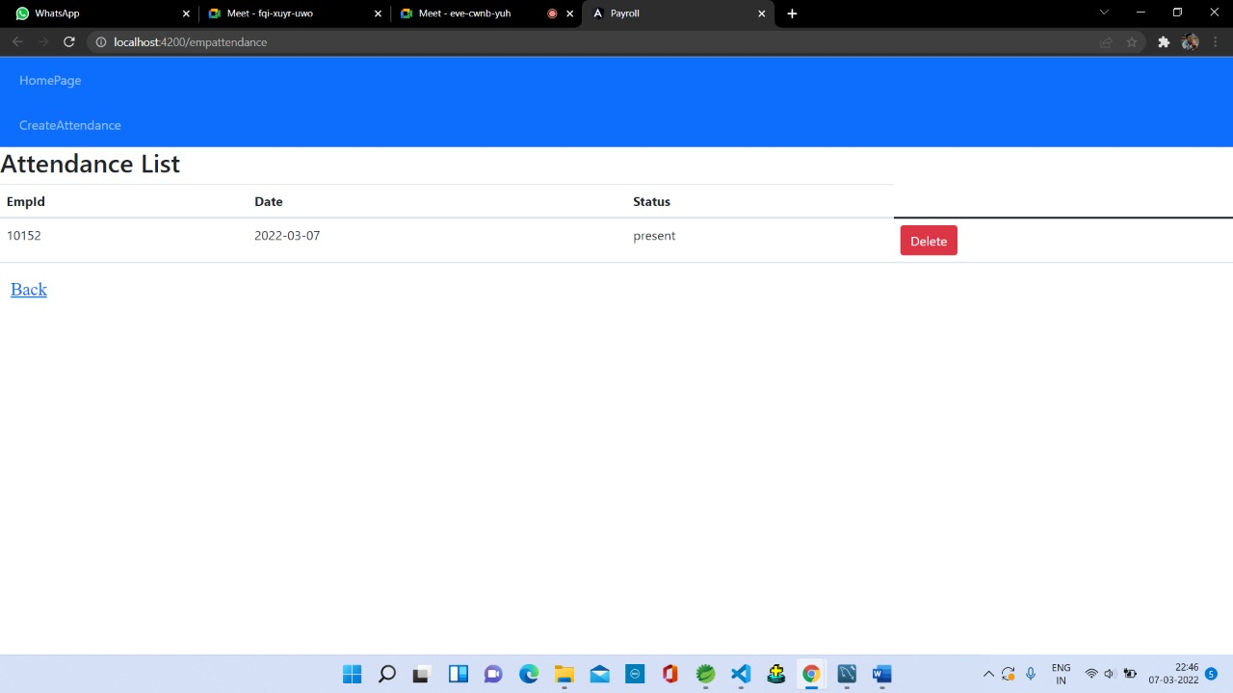
List of employee attendance

Slide 14
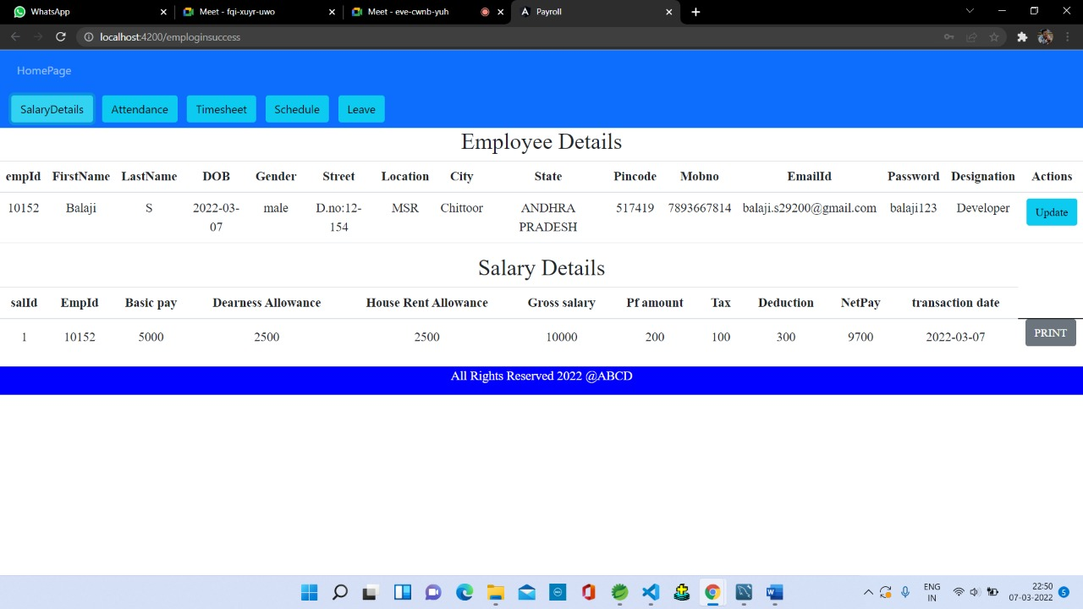
Employee profile & Pay slip

Slide 15
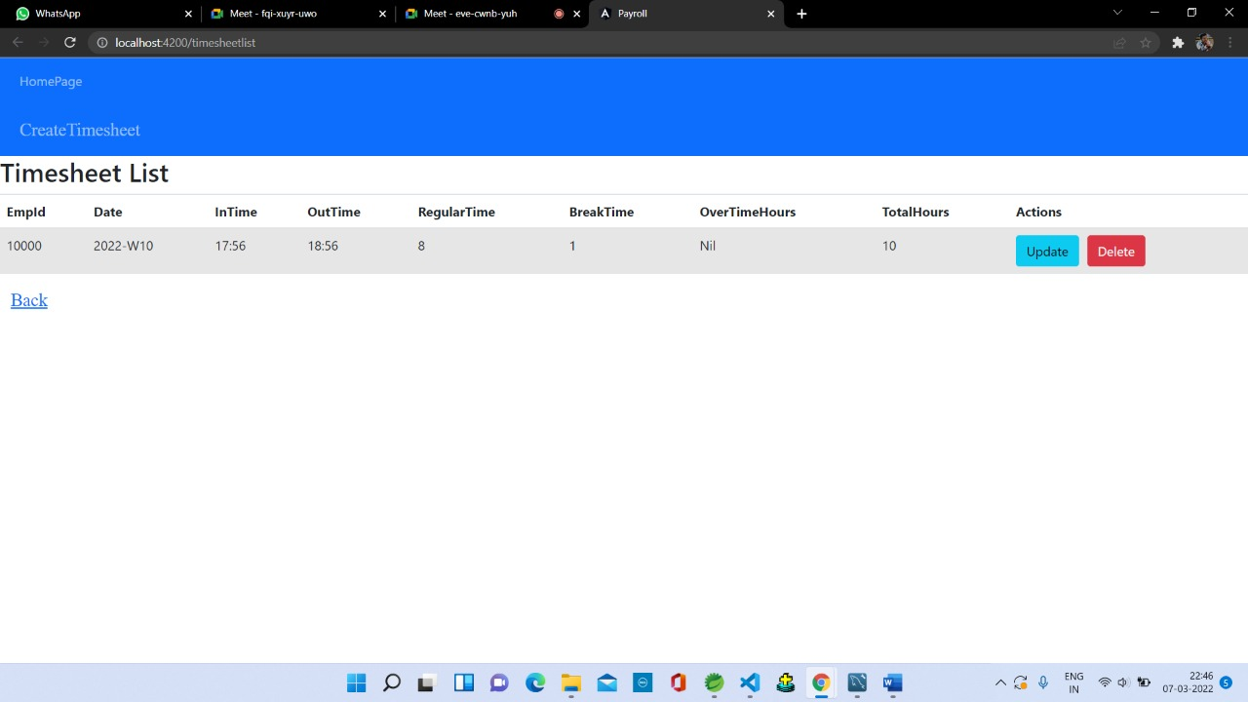
Timesheet List

Slide 16
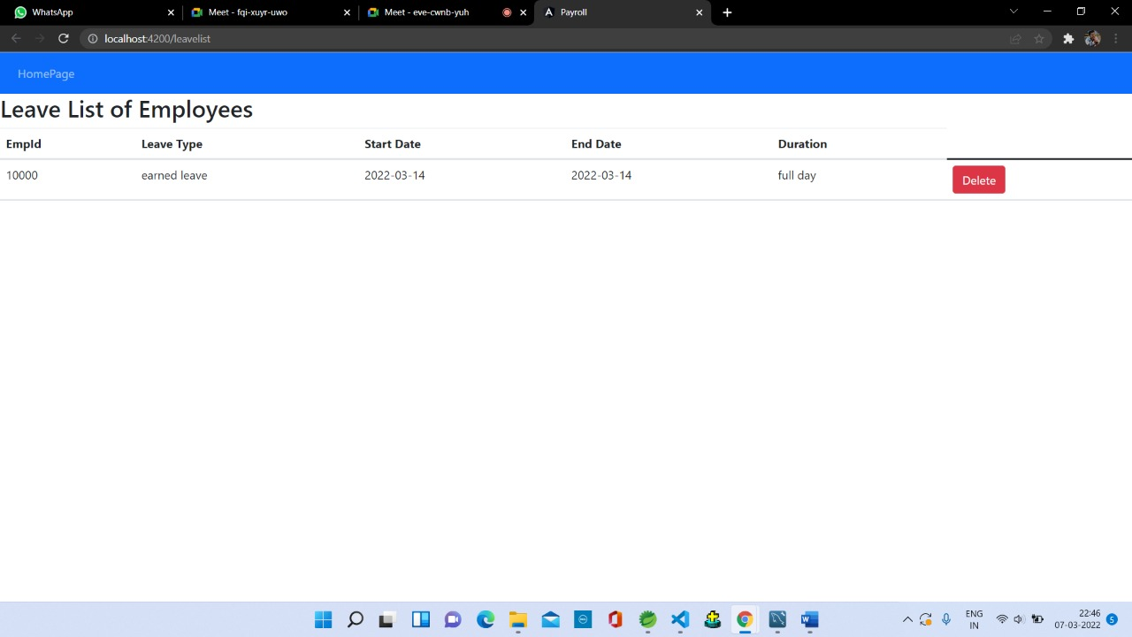
Leave list

Slide 17
Future scope and improvements
This Application works in Multiple PC’s installed on multiple Computers but sharing
Same database by which users of different department can use it sitting at different locations
simultaneously.
But in future we can make the Application where the database will be
hosted in order to manage the all departments which will be located in different places and
by keeping domain of Application as Online.
The system can be developed in such a way that its existing features can be modified to better versions.

Slide 18
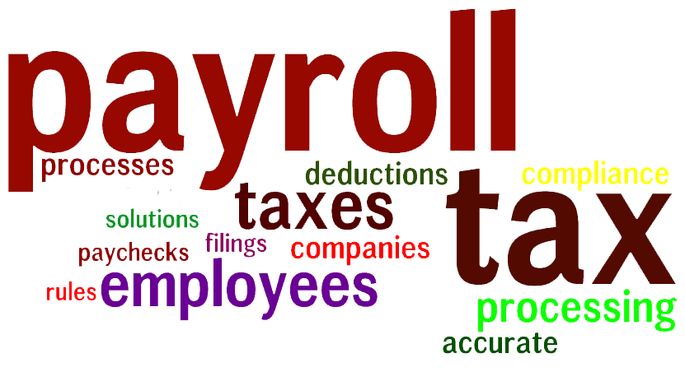
Conclusion
This project is built keeping in mind that it is to use by admin and the employees in an organization . It is built for use in small scale organization where the number of employees is limited. According to the requested requirement the admin can add, manipulate, update and delete all employee data in his organization. The admin can add new Employee and delete them. The Admin can also add predefined pay grades for the employees. The required records can be easily viewed by the admin anytime time he wants in an instant. The payment of the employee is based on monthly basis. Numerous validations implemented would enable the admin to enter accurate data. The main objective of this framework is to save time, make the system cost effective and management records efficiently.

Slide 19
Thank you

